Slide 1

Global Video Games Interactive Dashboard
‘Chris’ Jooyoung Cho,
Shao Xuan Chew,
Jiaming Pei,
‘Jessica’ Ziyue Wang,
‘Candice’ Xinyi Zhang,
‘Robert’ Xu Zhu,
‘Samuel’ Delin Zhu

Slide 2

Abstract
With the global video game sales data, we specifically studied the sales of console game to understand the changes in console game sales across different platform.
We used our exploratory data analysis to understand the data set and define the focus of our dashboard. We also found some columns that are suitable for filtering data to generate more insight.
Our final dashboard allows users to understand the video game market trend, compare the three main market leaders on their genre strategy, and details on individual games.

Slide 3


About the Dataset
This Kaggle Dataset covers the global sales volume of video games on different platforms from 1980 to 2020. It also contains the sales in markets like North America, Japan and European Union. For each game, basic information like publishing platform, year of release, genre and publisher are included. Additionally the critic score from Metacritic, user count, developer and ESRB user rating are provided.

Slide 4

Background
Video game industry
Our focus on Console game
Notes:
The overall video game industry is growing despite the pandemic, reaching 11.6 billion US Dollar in 2020. And the North America remains the major market.
Specifically, we want to study console video game with this dataset. Console games has its golden age before, while the sales has decreased facing the competition from mobile game, cross-platform game and PC game. We are curious in finding out how console game sales are related to the content of the games, for which different platform would use strategies to attract gamers.

Slide 5
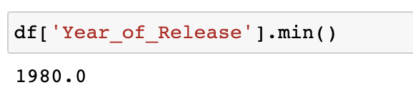
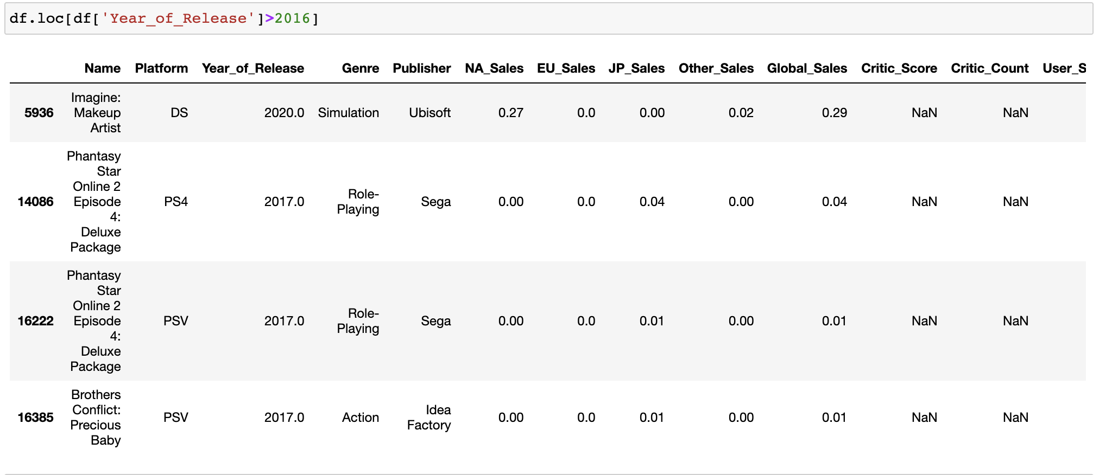
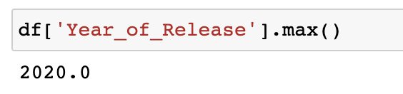
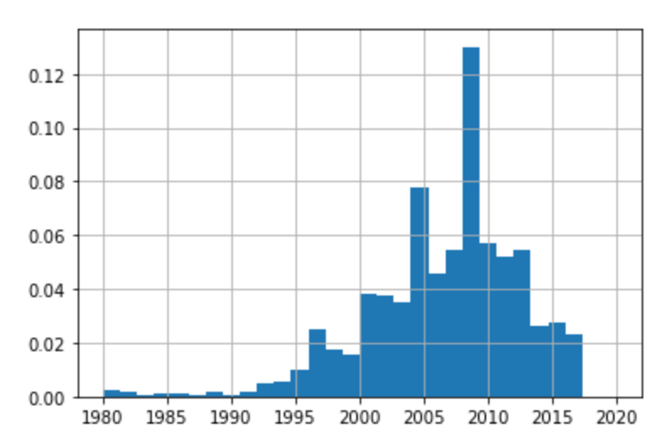
Exploratory Data Analysis: Missing Values
-> Narrow our focus on Console Games released between 1999 and 2016
Notes:
And here are some findings from our exploratory data analysis.
Although we found the min and max of Year of Release of the games are 1980 and 2020, we noticed that for game released before 1994 and after 2016 has a lot of null values especially in Critic and User score and there are only 4 games produced after 2016, so we narrow our focus on console games released between 1994 and 2016 to have representative insights.

Slide 6
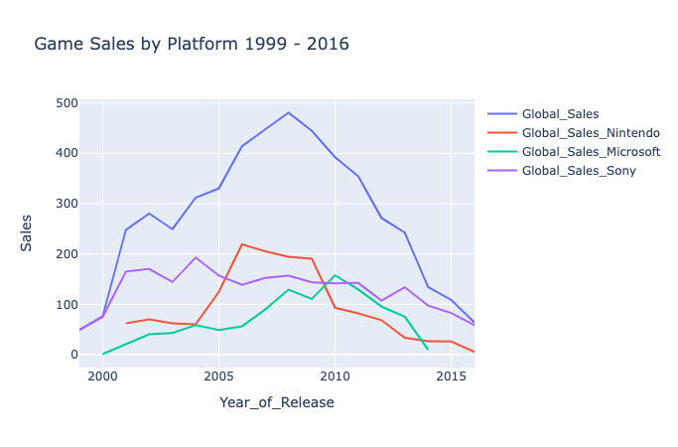
Exploratory Data Analysis: Year of Release VS Sales
Period 1
Period 2
Period 3
Notes:
We then look at the video games’ global sales performance among the 3 major console platform: nintento, sony and microsoft between 1999 and 2016, and we divided the observation years into three periods: growing market, golden age and the shrinking market by looking at the sales volume and also the time of market entry of specific game console from the 6th to 8th generation.

Slide 7
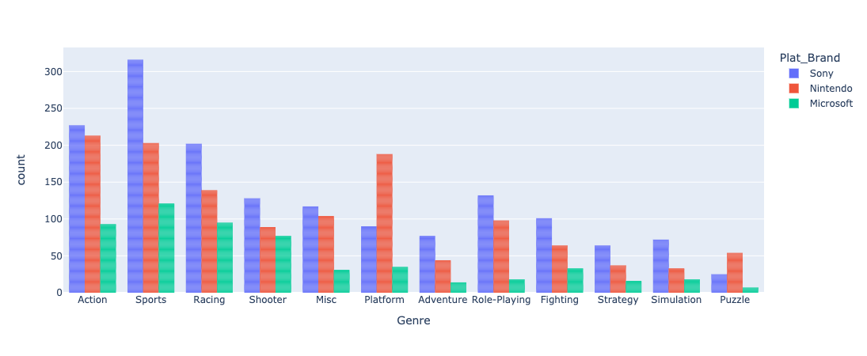
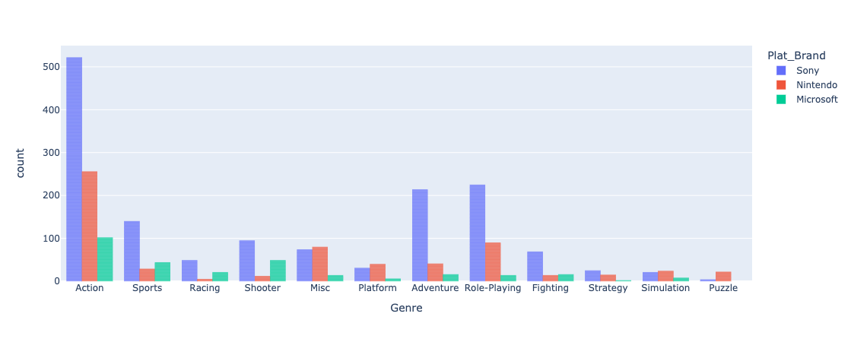
Exploratory Data Analysis:
Platform’s strategy based on the games released by genre (Period 1-3)
Period 1
Period 2
Period 3
Notes:
We explore more on the platform’s strategy based on the games released by genres in the three time period. Though the platforms have shifted their focus in genre strategy, Nintendo and Sony are able to maintain their focus on differentiated market, but Microsoft seems to have no specific focus. And Nintendo and Sony are competing against each other on the first place of sales, while microsoft failed to gain more market share.

Slide 8
Global game sales by period and platform
(Sales : Million copies)
Platform manufacturer |  | Period 1 (1999 ~ 2004) | Period 2 (2005 ~ 2011) | Period 3 (2012 ~ 2016)
Sony | Global Sales | 1099.25 | 1345.17 | 585.99
 | Game Release | 1551 | 2901 | 1469
Nintendo | Global Sales | 608.51 | 1775.12 | 304.99
 | Game Release | 1266 | 3735 | 628
Microsoft | Global Sales | 192.04 | 784.96 | 234.96
 | Game Release | 558 | 1185 | 292
Notes:
Key takeaways
1. Number of games released is related to the Sales amount
2. Differentiated strategies are necessary to survive in the video game industry.
Our conclusion on this time period dimension is that the video game market is different for the three periods, so a filter of time/year is essential for the dashboard. And we would like to see how other metrics changes with time.

Slide 9
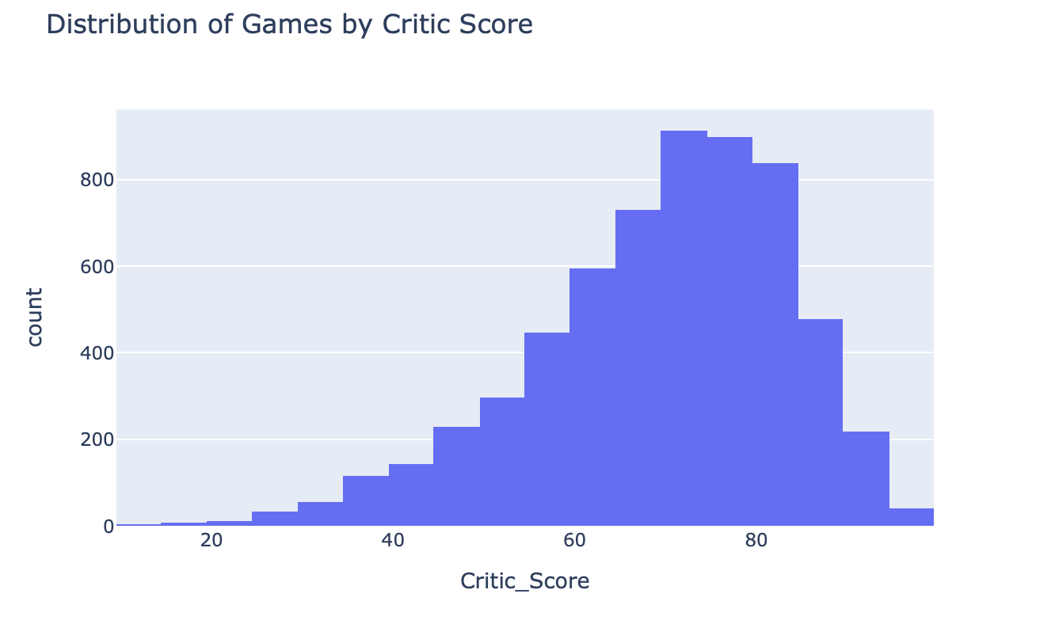
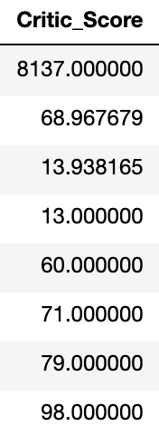
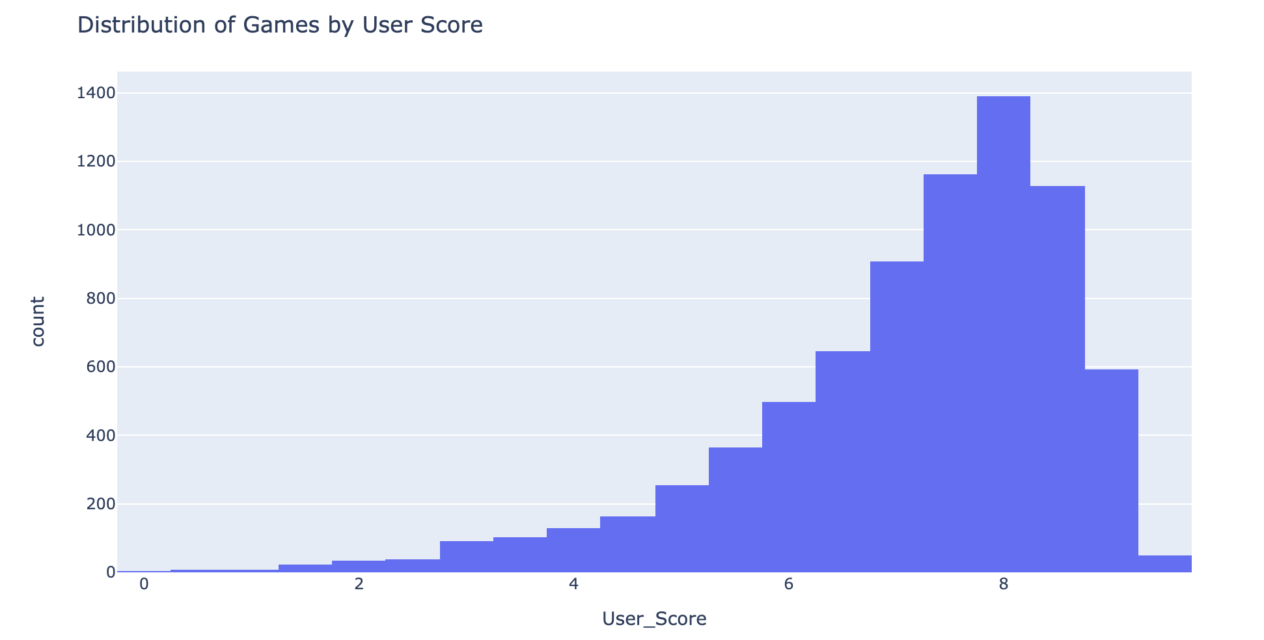
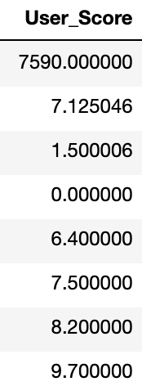
Exploratory Data Analysis:
Critic/User Score Distribution
Notes:
We also investigate more are critic score and user score of games.
This is the distribution plot of critic and user score of all the games in the dataset. As part of the content strategy of console platform company high-reviewed games generally means better quality and potentially leads to more demand from gamers. So these Score would be a key metric for our dashboard

Slide 10
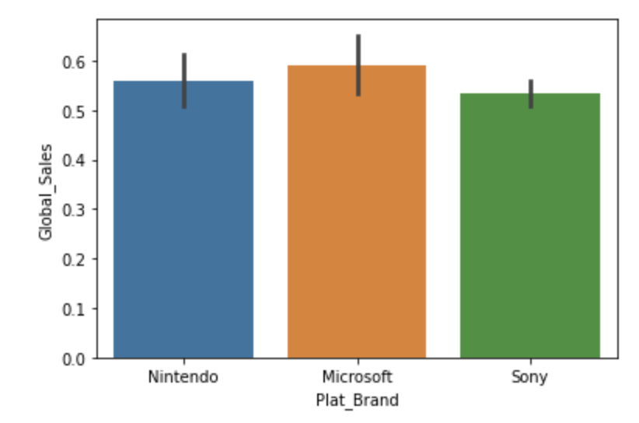
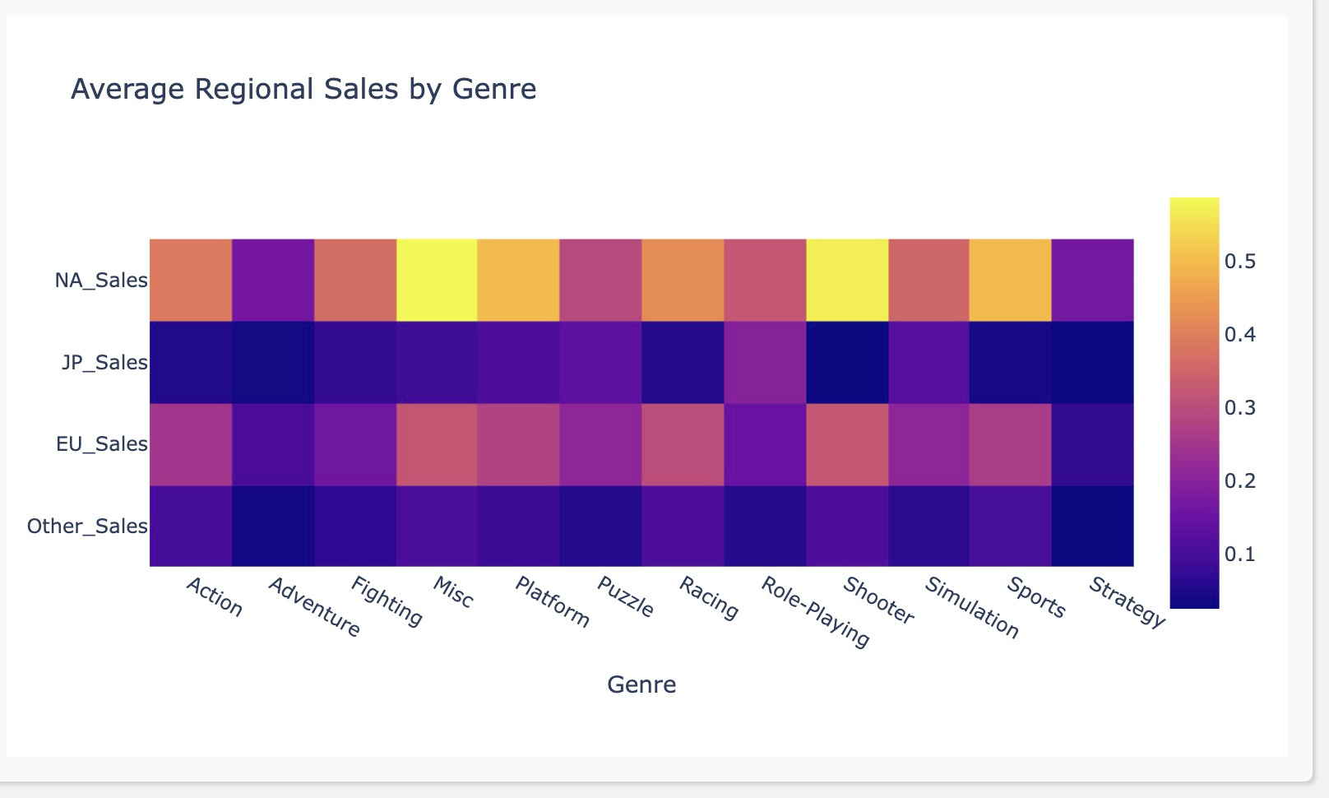
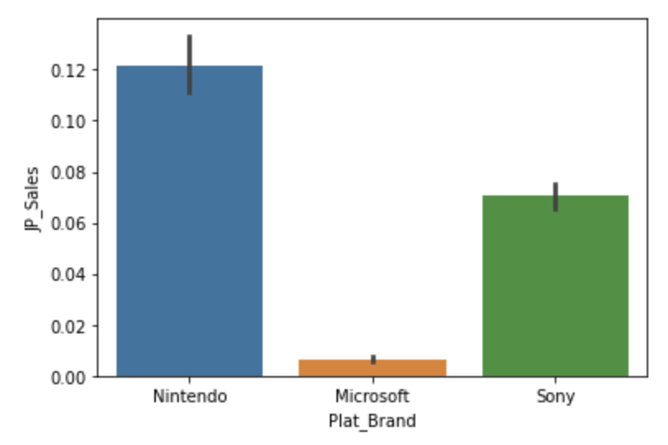
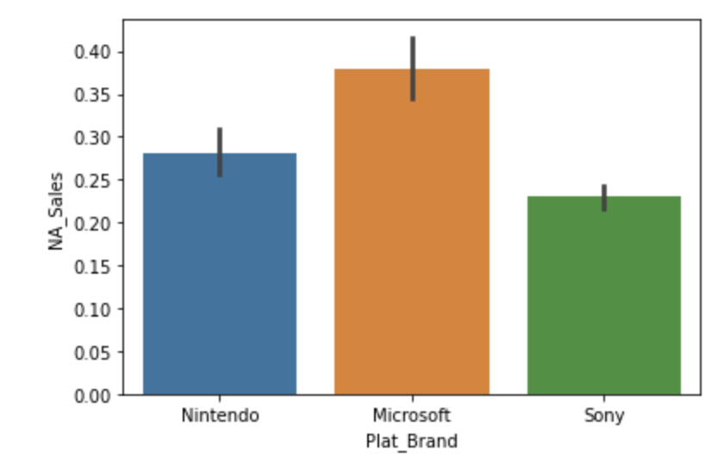
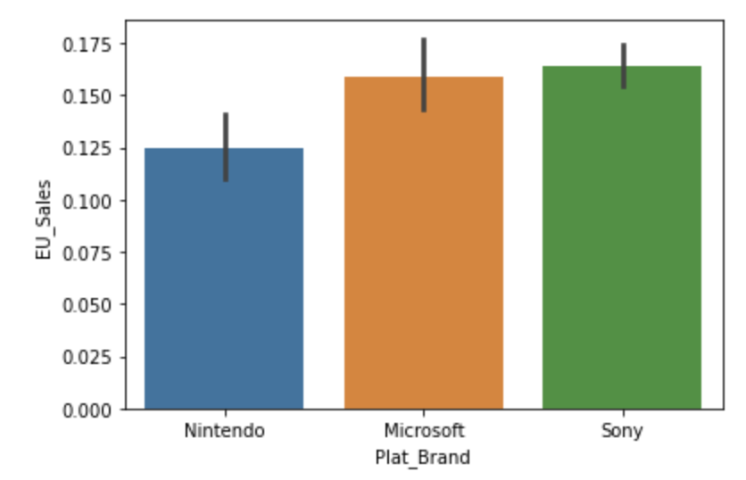
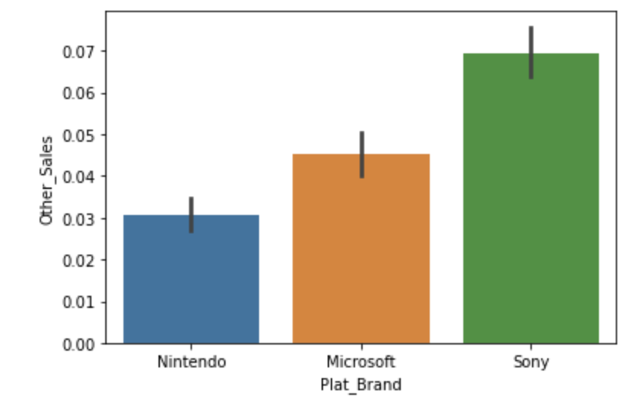
Exploratory Data Analysis:
Influence of Geographical Region on sales
Notes:
We also explore the relationship between region and sales
We found that even though the global sales of the three brands are similar, they have significant different performance in different regions.
We also found that different regions have different preferences toward different genre of video games, and according to our previous analysis on how each brand is performing on each genre, we think this dimension of region could be used later.

Slide 11
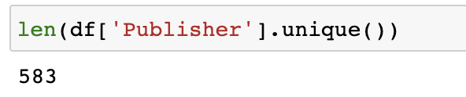
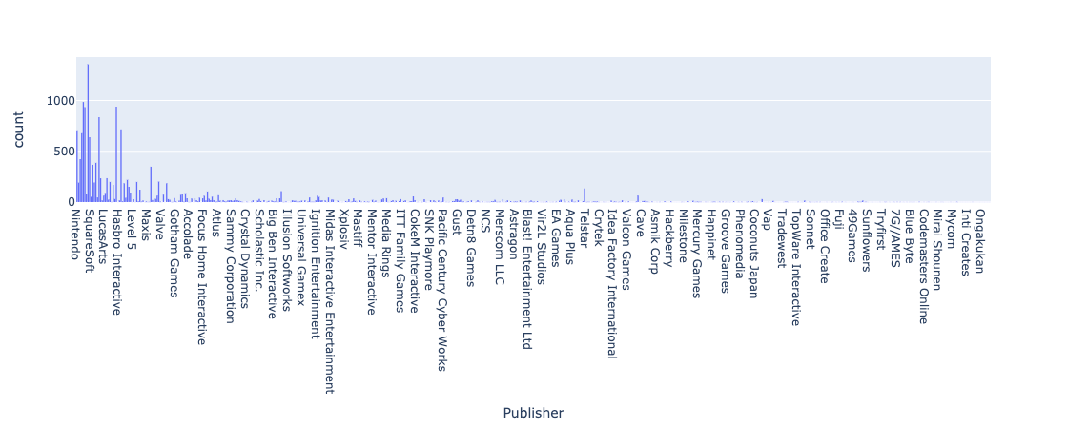
Exploratory Data Analysis:
Publishers
Notes:
There’s also a column showing the publisher of individual games, although there are 583 unique publishers, there’s clearly some of them dominates the market.
Some publishers published much more games than others, so we expect some users would want to narrow their search for more popular publishers

Slide 12
Target Dashboard Users
Market Profitability
Geographical Difference
Market Leader Comparison
Successful Games
Target User description:
Consultant, Game industry analysts and investors who want to understand the trend of console game markets and the different market strategies.
How does console game sales change over time?
Which geographical area is best market?
What makes each console stand out? Which genre does each console have the best performance?
What are some examples of successful games in the history?
Notes:
Before introducing the dashboard, we would like to first define our target dashboard users and their business problems.

Slide 13
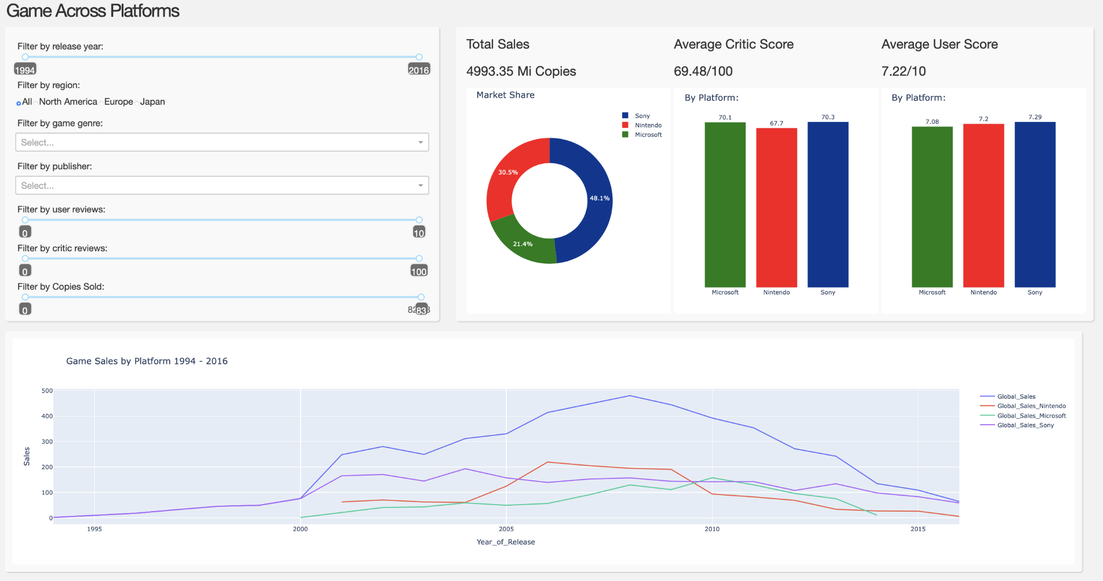
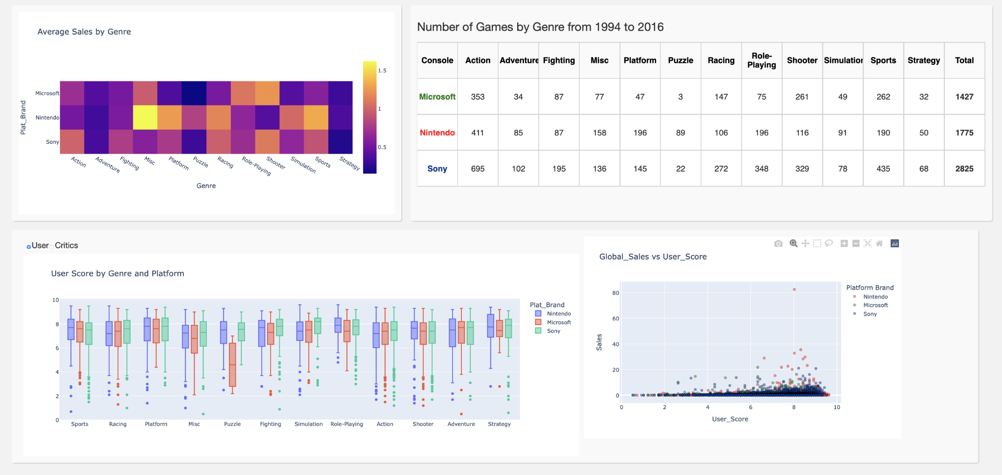
Dashboard
Overview
Main UI
Focus on key metrics
By console platform
Overview of market
Lowest granularity
Sales/Number of games
By Genre
Medium granularity
User/Critic Score
Genre->Game performance
More details
Notes:
Concluding EDA:
We mainly focused on the Big 3 console platform to investigate their content strategy on exclusive games as well as specific genres. But there are more to the dataset related to the interactions between different platforms, game publishers and regions, etc.. We hence built a dashboard presenting the overall global console video game trend.
Consists of… (what kind of chart, graph)
The general logic of our dashboard is ...

Slide 14
Top: Main User Interface
Notes:
This is the main interface our dateboard, in which users can control the dashboard by the filters on the left and see the overall performance of the market and a look at how different console brand perform with three different metrics.

Slide 15
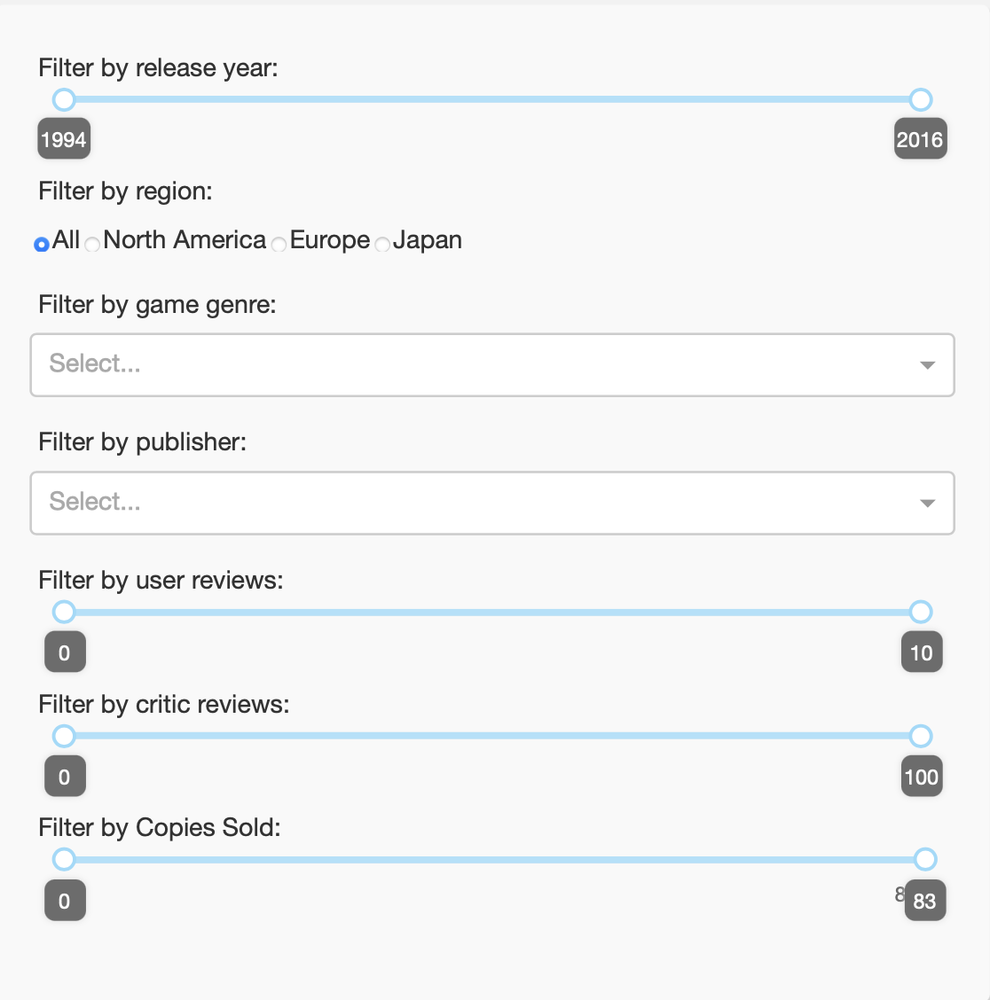
Filters
Release Year reflects different period
Region is a strong variable for the performance of each console and genre
Genre is a definite category of games, reflects the targeting strategy
Publisher is an attribute of games, helping users to narrow down their search
Review scores filters help users to focus their research on specific level of game quality
# of Copies Sold help users focus on games of certain market sizes
Notes:
Our decision on filters comes from our exploratory data analysis.

Slide 16
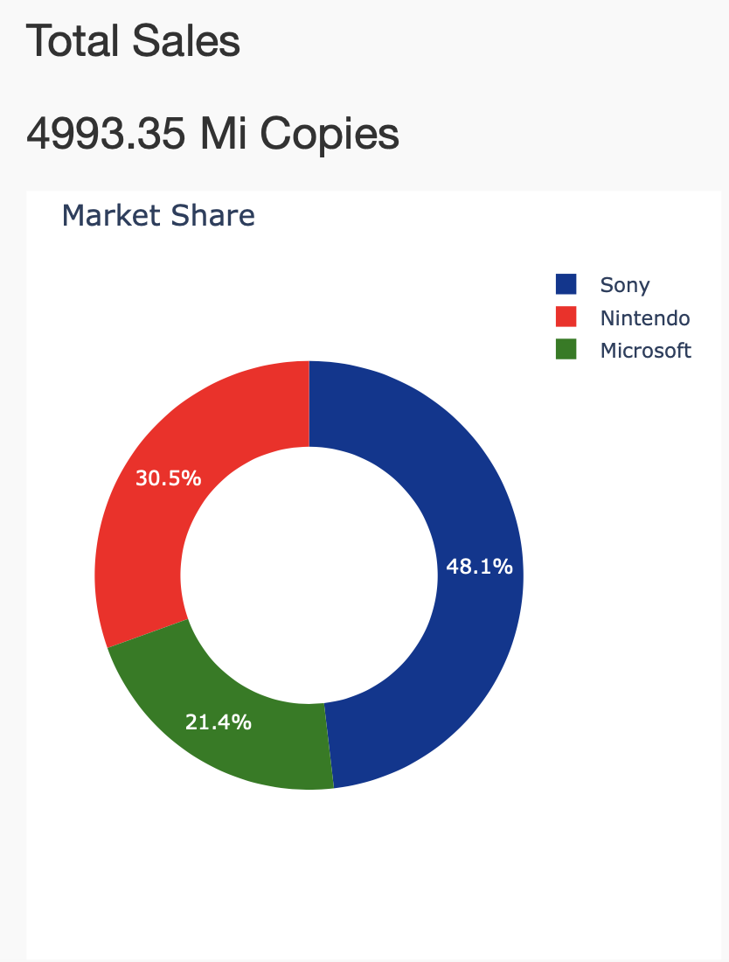
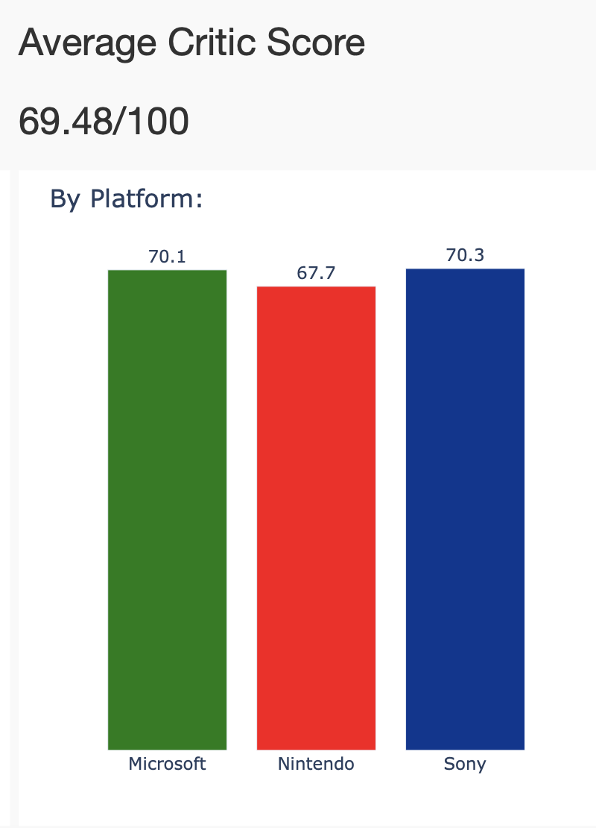
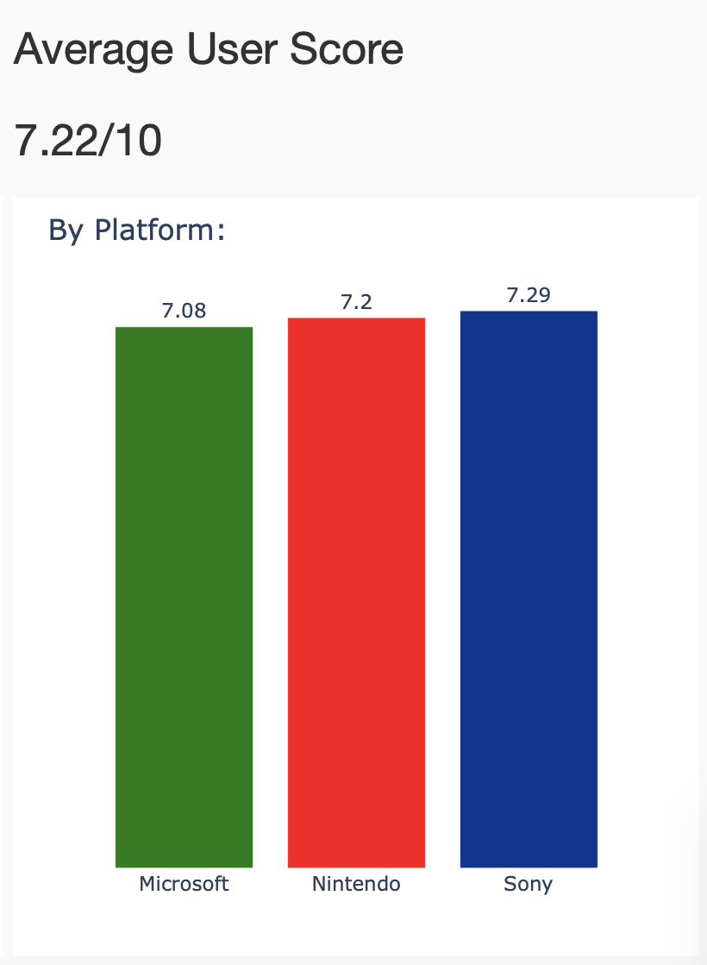
3 Key Metrics
Sales
Critic Score
User Score
Measures Popularity
Measures Quality
Measures User Experience
Notes:
3 key metrics are used here.
We measures the popularity of games by their sales, the quality of the game by the Metacritic scores. We also have the user rating of games as the user experience measurements. This enables users to see how the quality and user experience would affect the market share of consoles. Users can use all the filter on the left to customize their investigation on each console brand’s performance.

Slide 17
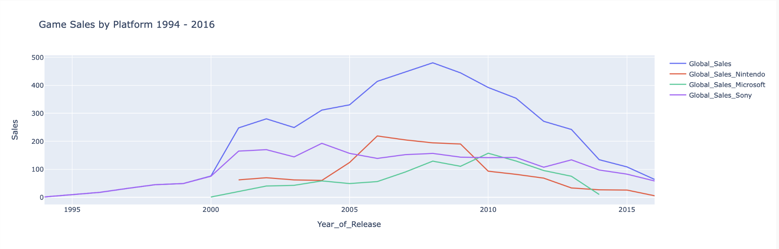
Line Plot: Sales generate by the games launched in each year
Filter: Year
Filter: Region
Insights
Market Trend
Performance of each console
Filter: Genre/Publisher/Review Score/#Sales Copies
Notes:
Then, we have a Global Games Sales chart as discussed earlier in our EDA, to show the overall Console Game market trend over time. We plot it as an interactive line chart for our dashboard user to easily check the sales volume of each platform at any given year. Users can also further filter the line plot to by other dimensions to study the sales performance of the particular kind of games they are interested in.

Slide 18
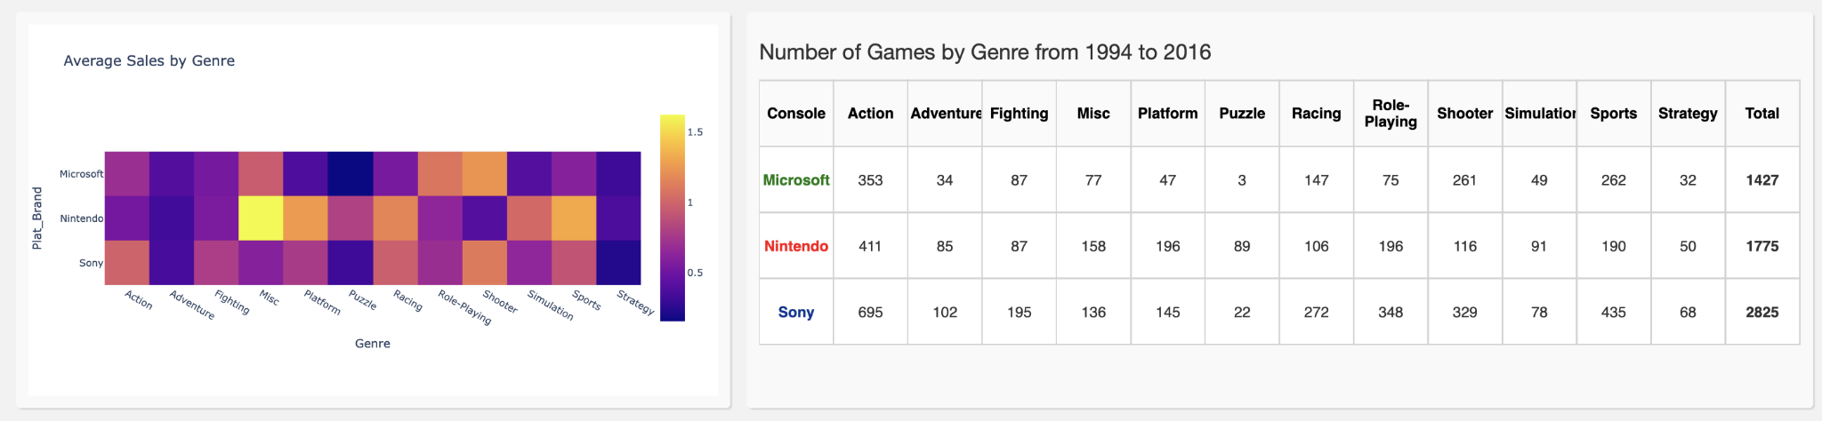
Middle: Console Platform VS Genre
Notes:
Then when we scroll down a little, we can see the middle part of the dashboard, focusing specifically on different console platform’s performance on each game genre.

Slide 19
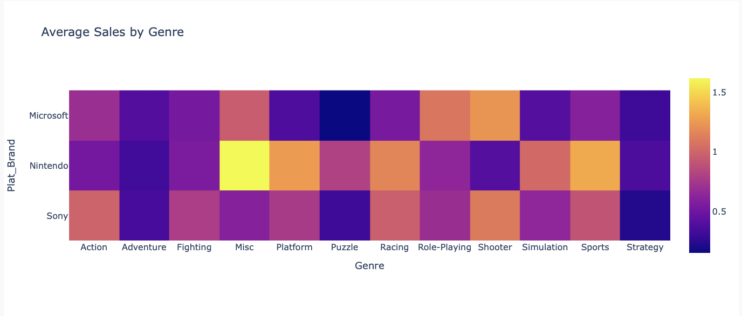
Heatmap: Average sales by Genre
Filter: Genre
Insights
The top performing genre of each console
Filter: Year/Publisher/Review Score/#Sales Copies
Notes:
First, we put a heatmap on the left, showing the performance of each genre produced by each console brand by color difference.
We are able to change the input in the genre filters to narrow down over focus, and also other filters to further investigate other specific groups like how the top performer in genre is different when comparing different periods.

Slide 20
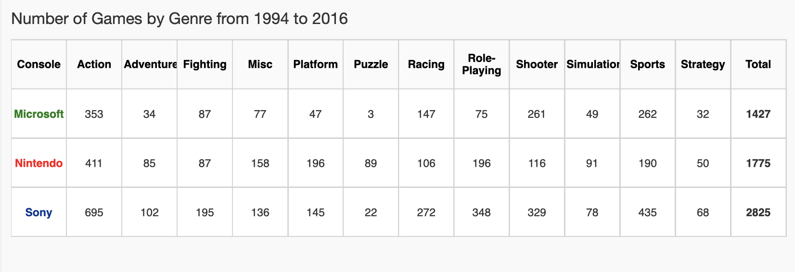
Table: #Games per Genre for each console platform
Filter: Year
Filter: Genre
Insights
Filter: Publisher/Review Score/# Sales Copies
The content strategy/genre emphasis of each console
Notes:
Besides the performance, we also all learn more about content strategy of each console. This table shows number of games on different platforms of different genres. Seeing the number of games produced in different genres by different brand, users can understand the content strategy and genre emphasis of each console platform with this table.

Slide 21
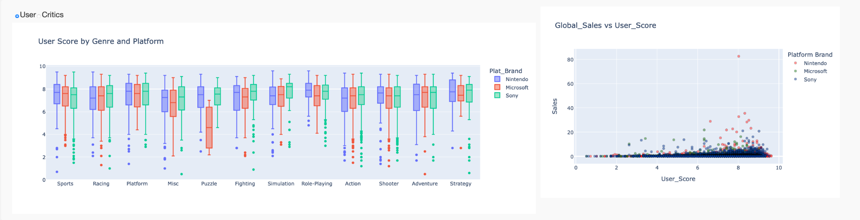
Bottom: Genre + Individual Game performance for each console platform
Notes:
And this is the final part of our dashboard, focusing on critic scores and user scores on the granularity of genre and individual games. The two graphs are both controlled by the toggle switching between user score and critic score, which is from the top left

Slide 22
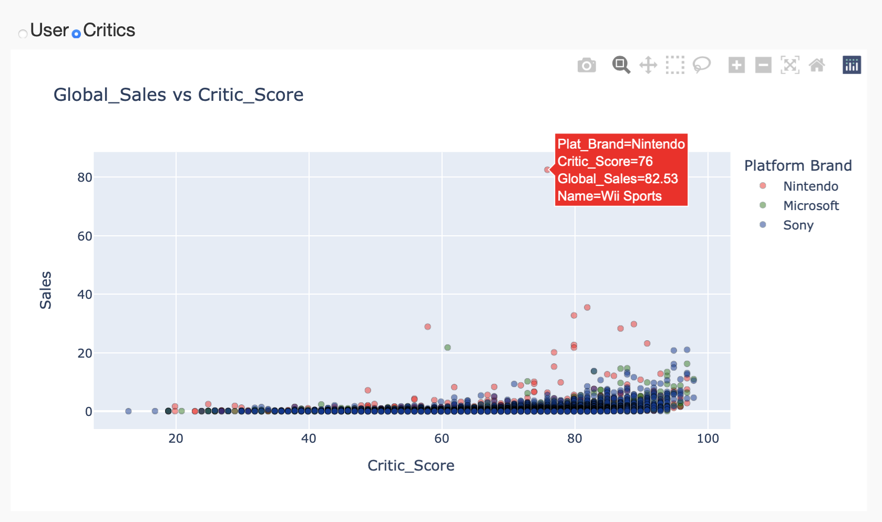
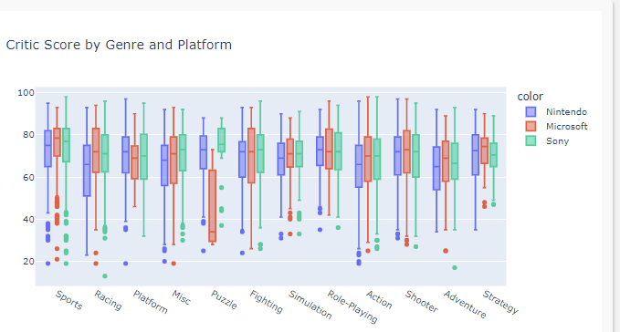
Critic Score by Genre and Platform
Filter: Genre
Toggle: User/Critic
Insights
How each platform perform differently on each genre
Filter: Year/Publisher/Review Score/#Sales Copies...
Notes:
On the left, we put a box plot showing how each console brand scores in different genres. We can have a view on how each platform perform in different genres using the median and we can also know how stable the performance is by looking at the IQR.
We can also connect this graph with the table of number of games produced to see further relationships.
Major platform usually build their competitive advantage by investing large budget to create exclusive games as part of their content strategies. So with a visibility of how each platform perform on different game genres, we can have another dimension of evaluating their content strategy.

Slide 23
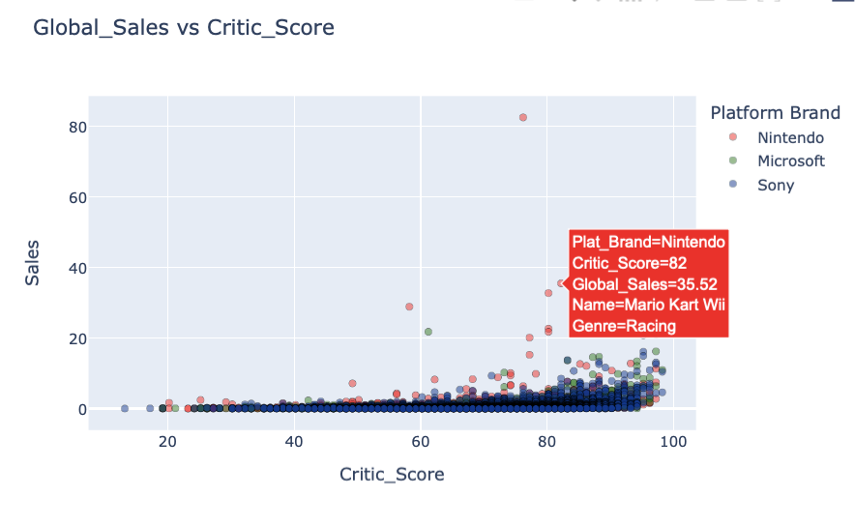
A Closer Look at the performance of individual games
Insights
Top Performing Game within the selected group
Filter: Year/Genre/ Publisher/Review Score/etc
Notes:
This is the very last graph included in our dashboard. A scatter plot showing the relationship between sales and score. A successful game is defined by one that has high sales figure and also high score. When we hover over the dots, we can see the detail and know the name of the game and genre of the game. We can use the filter to narrow down our focus and see the top performing game within the selected group on the two dimensions of sales and score.

Slide 24

Key Takeaways from the Dashboard
Platforms
Genres
Market
Platform’s market position
Genre selection and emphasis for each platform
Games
General view of video game market (Global/US/EU/JP)
The top performing game within the group selected
Notes:
After going through each graph of the dashboard. Here are some key takeaways or learnings that could be generated from our dashboard.
- Provide potential users and investors an overview of the global and regional video games market by sales volume.
- Show different platforms' market position in the market by the three key metrics of sales, critic score and user score.
- Show different platforms' business strategies through various dimensions and filters, and how successful the business strategy is.
- Provide an evaluation matrix of individual games by sales and score. Showing the top performing game within the group selected.
This dashboard is useful for our target users because it can cover as broad as the video gaming market, the performance of market leaders, their business content strategies and their successful games to make decisions on investment.
For other users, this dashboard would also be helpful.
- Gamers from different regions can filter different game genres or publishers based on the their personal interest, so that they can observe the related critic/user scores on different platforms in order to help themselves to choose the most suitable platform and the game to play.
- Platforms can observe the sales performance in different periods of time to predict the future trends of sales or customers’ preferences to better consolidate their customer base in the market and become the market leader.

Slide 25
References
https://www.investopedia.com/articles/investing/080515/economics-gaming-consoles.asp
https://www.prnewswire.com/news-releases/report-video-games-contribute-90-billion-to-us-economy-301185657.html
https://www.statista.com/statistics/246888/value-of-the-global-video-game-market/
https://www.marketwatch.com/story/videogames-are-a-bigger-industry-than-sports-and-movies-combined-thanks-to-the-pandemic-11608654990
Haeyop Song, Jaemin Jung & Daegon Cho (2017) Platform Competition in the Video Game Console Industry: Impacts of Software Quality and Exclusivity on Market Share, Journal of Media Economics, 30:3, 99-120, DOI: 10.1080/08997764.2018.1449750

Slide 26
Background
Competition between different Console Platform highly related to game genres and overall Content Strategy
New console release boosts game sales, as the software sales increase 22% to $44.5 billion in 2020 with the release of Microsoft and Sony’s next-gen consoles. Contrarily, Cho et al. (2018) demonstrated that high-quality software also has a significant effect on hardware demand.
With the rise of digital-copy game sales, mobile games, and cross-platform games that aren’t limited to a specific console, game sales might be less dependent on the console release and platform limit.
Different console platforms strategically target different gamer groups with exclusive games of specific genres.
Notes:
Specifically, we want to study console video game with this dataset. Console games has its golden age before, while the sales has decreased facing the competition from mobile game, cross-platform game and PC game. Console game sales also highly related to the content of the games, for which different platform would use strategies to attract gamers.

Slide 27

Exploratory Data Analysis:
Platform’s strategy based on the games released by genre (Period 1)
Sony
Most games
Traditional Genre
Adult, enthusiastic gamers
Nintendo
2nd most games
Traditional genre
Family genres
Microsoft
Traditional + Adult + Family
No differentiation
Notes:
Sony released most amount of games in the period as the market trailblazer. And it was leading in those traditional game genres like sports, actions and racing. Nintendo closely followed Sony in game releases in those traditional genres. While Nintendo also led in releasing Platform and Puzzle game, which were leisure-oriented games like Super Mario. Microsoft was late comer to the market and seemingly did not focus on certain genres particularly, trying to attract all gamers.

Slide 28
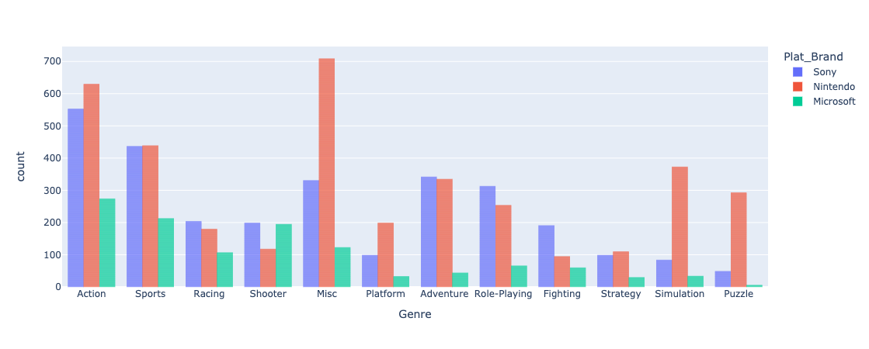
Exploratory Data Analysis:
Platform’s strategy based on the games released by genre (Period 2)
Nintendo
New platform Wii
Most games
Family + Traditional
New genres
Sony
2nd most games
Traditional genre
Family genres
Microsoft
Traditional + Adult + Family
No differentiation
Notes:
Nintendo became the market leader during the Golden Age of console game by not only dominating the family and leisure games market, but also released more Action and Sports games, as they announced the New Generation Wii console. The strategies along with new console successfully won over the gamers. Sony continued its focus on traditional genres, even though its sales volumes dropped. Sony tried to attract more family users driven by Nintendo’s success but not as effective as imagined. Compared to other competitors, the number of games released by Microsoft has not increased significantly. There is no particular strategy in the game content.

Slide 29
Exploratory Data Analysis:
Platform’s strategy based on the games released by genre (Period 3)
Sony
Most games
Traditional genres
Back to original strategy
Nintendo
2nd most games
Traditional genre
Family genres
Microsoft
Traditional + Adult
No differentiation
Notes:
he console game market was facing competition from PC games and Mobile game. Sony retook the lead by continuing its strategy of releasing large-budget exclusive traditional games to keep its game enthusiast users during the tough time. On contrary Sony significantly reduced its distribution on other types of game. Nintendo took a similar approach as Sony’s to focus on Action and Role-Play games that are popular among Asian game enthusiasts to maintain its second position. Microsoft failed to locate an effective differentiated strategy in the market and released far fewer games than its competitors.

